Slide 1
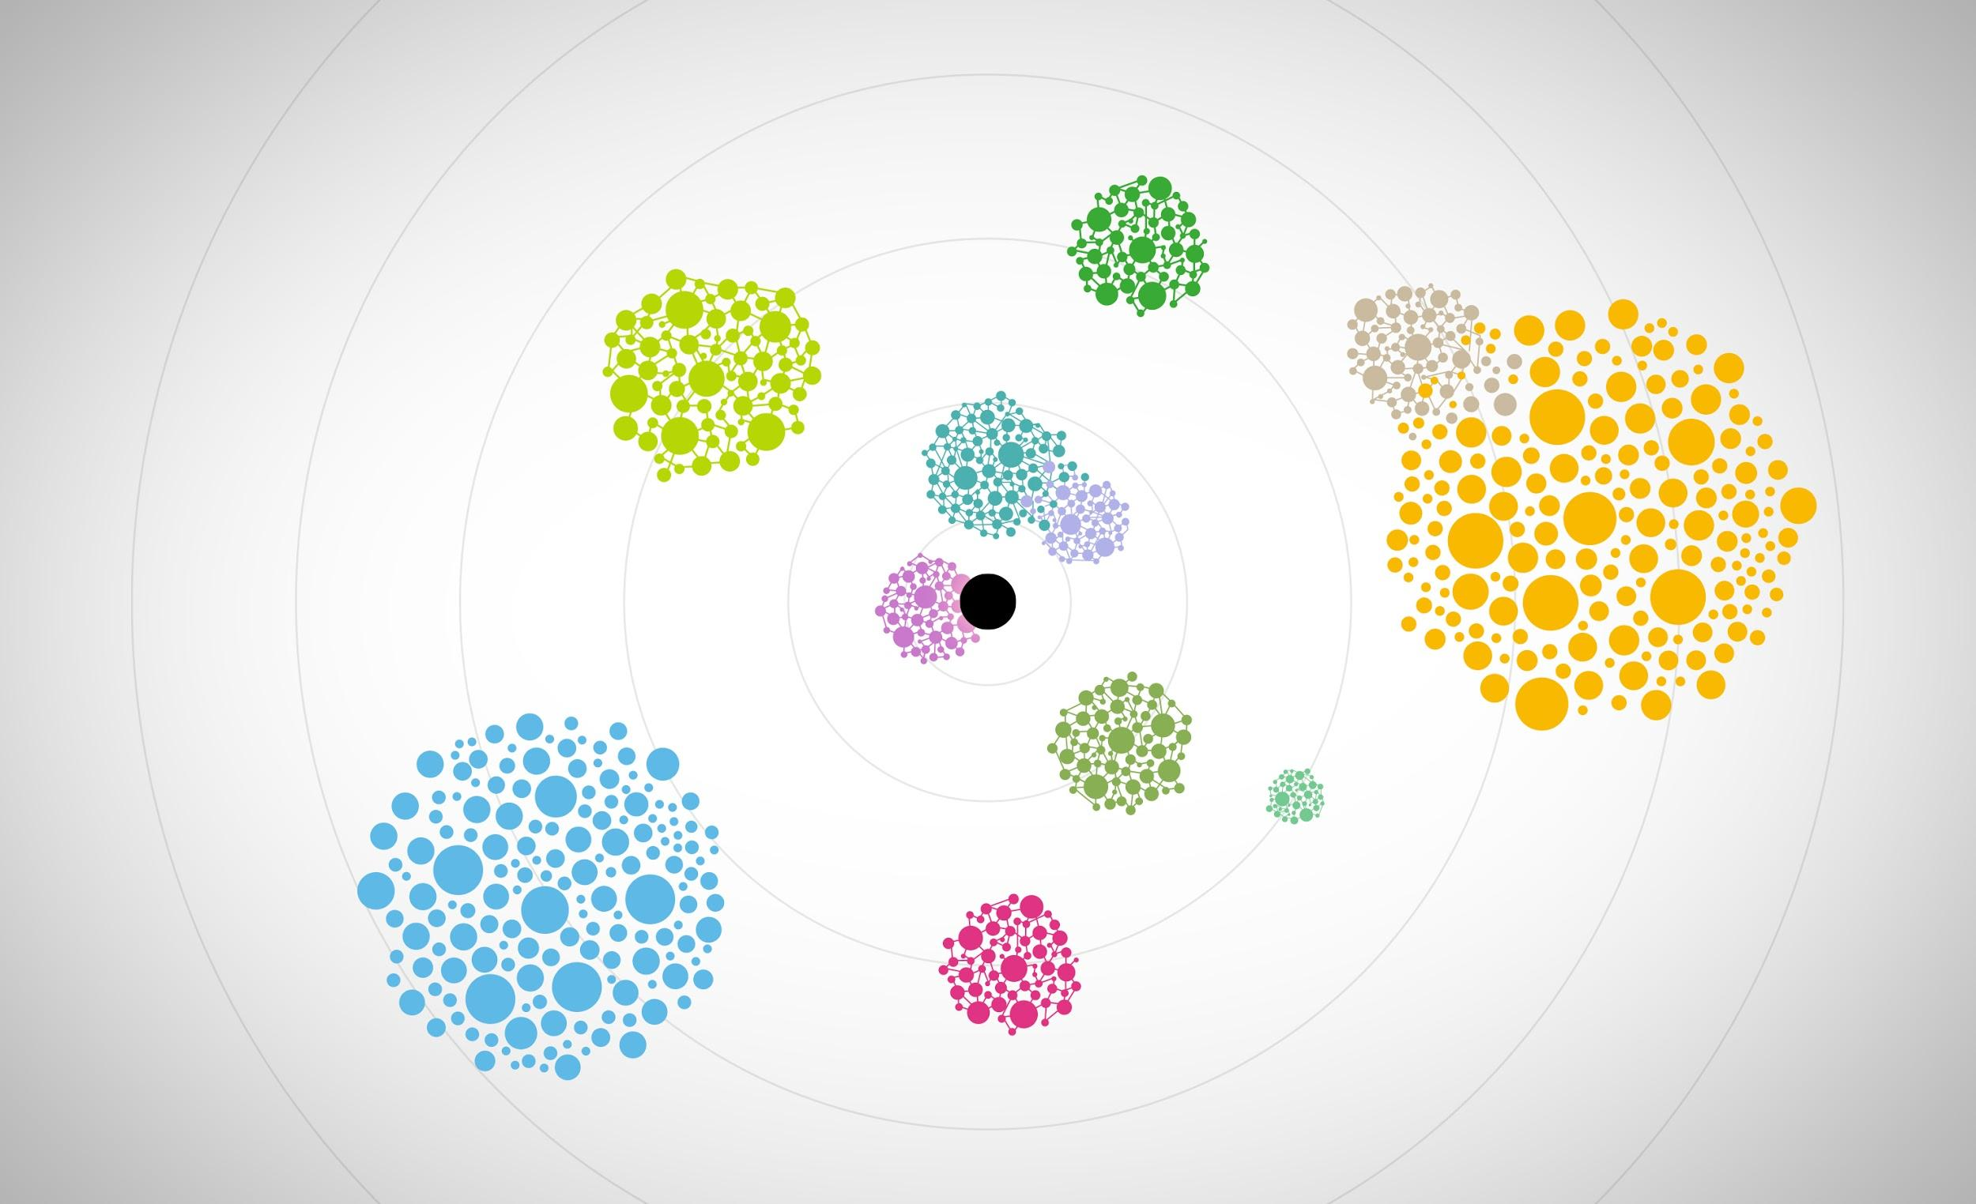
Deep Speech & Common Voice
Kyrgyz Voice Hackathon
Josh Meyer
Mozilla Machine Learning Group
Notes:
First I want to thank you for the invitation to participate in this hackathon
And, by way of introduction, I’m Kelly Davis, Manager of the Machine Learning Group at Mozilla
In this presentation I’m going to give an introduction to two topics:
Deep Speech, our open speech recognition engine, and...
Common Voice, an app and website used to collect open speech data sets
After this we’ll have a break, then I’ll follow o with two other lectures that go into more depth. The first lecture will cover Common Voice, the second Deep Speech.

Slide 2
1.
Introduction
Mozilla + Mozilla Machine Learning Group
2.
How Voice Assistants Work
A Multi-Layer Process
3.
Deep Speech
Open Source Speech Recognition
4.
Common Voice
Democratizing Speech Technologies
Notes:
The agenda of my talks is as follows...
First, I will give a brief introduction to the Mozilla Machine Learning Group
Next I’ll give a quick description of how voice assistants work, covering the basics in order to frame the topics I’ll touch on later
After that I’ll give an introduction to Deep Speech, our open speech to text engine and...
Common Voice our app and website used to collect open speech data sets

Slide 3
Introduction
Notes:
So, let us get started with the introduction to the Mozilla Machine Learning Group...

Slide 4


Slide 5
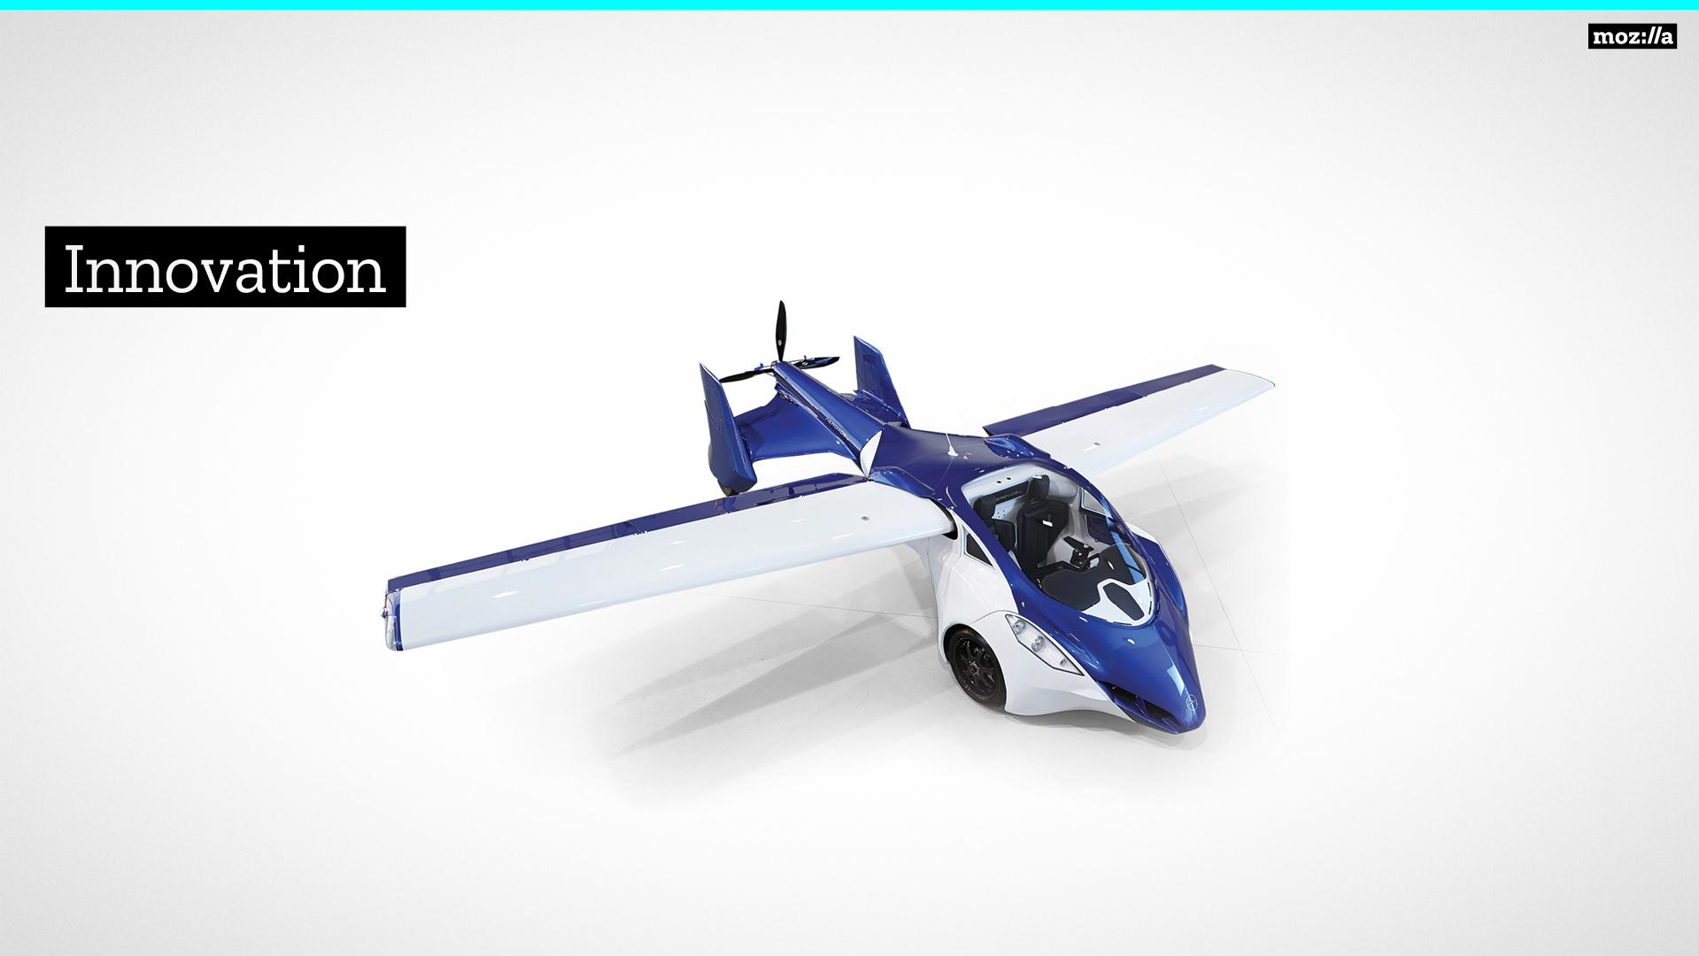
Notes:
Innovation, the stereotypical “flying car,” is usually pursued in the corporate world in a very standard way...

Slide 6
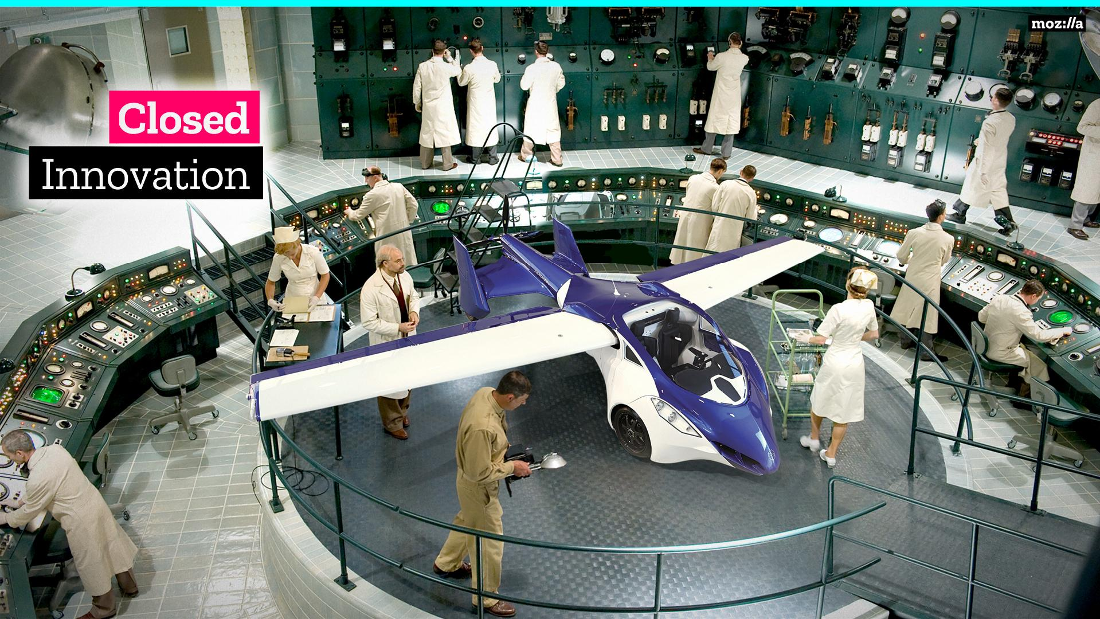
Notes:
A corporation sets up a research lab, populates it with smart people, and sets them off on the task of inventing the latest and greatest “widget”.
These “wonder widgets”, how they were made, their materials, and their IP are all sealed off behind the walls of this corporate giant.
However, there are numerous corporate labs doing just the same thing, creating the next “wonder widget”...
Making the same mistakes, having the same successes, basically duplicating massive amounts of work.
It’s such a waste!
Things could be so different!

Slide 7
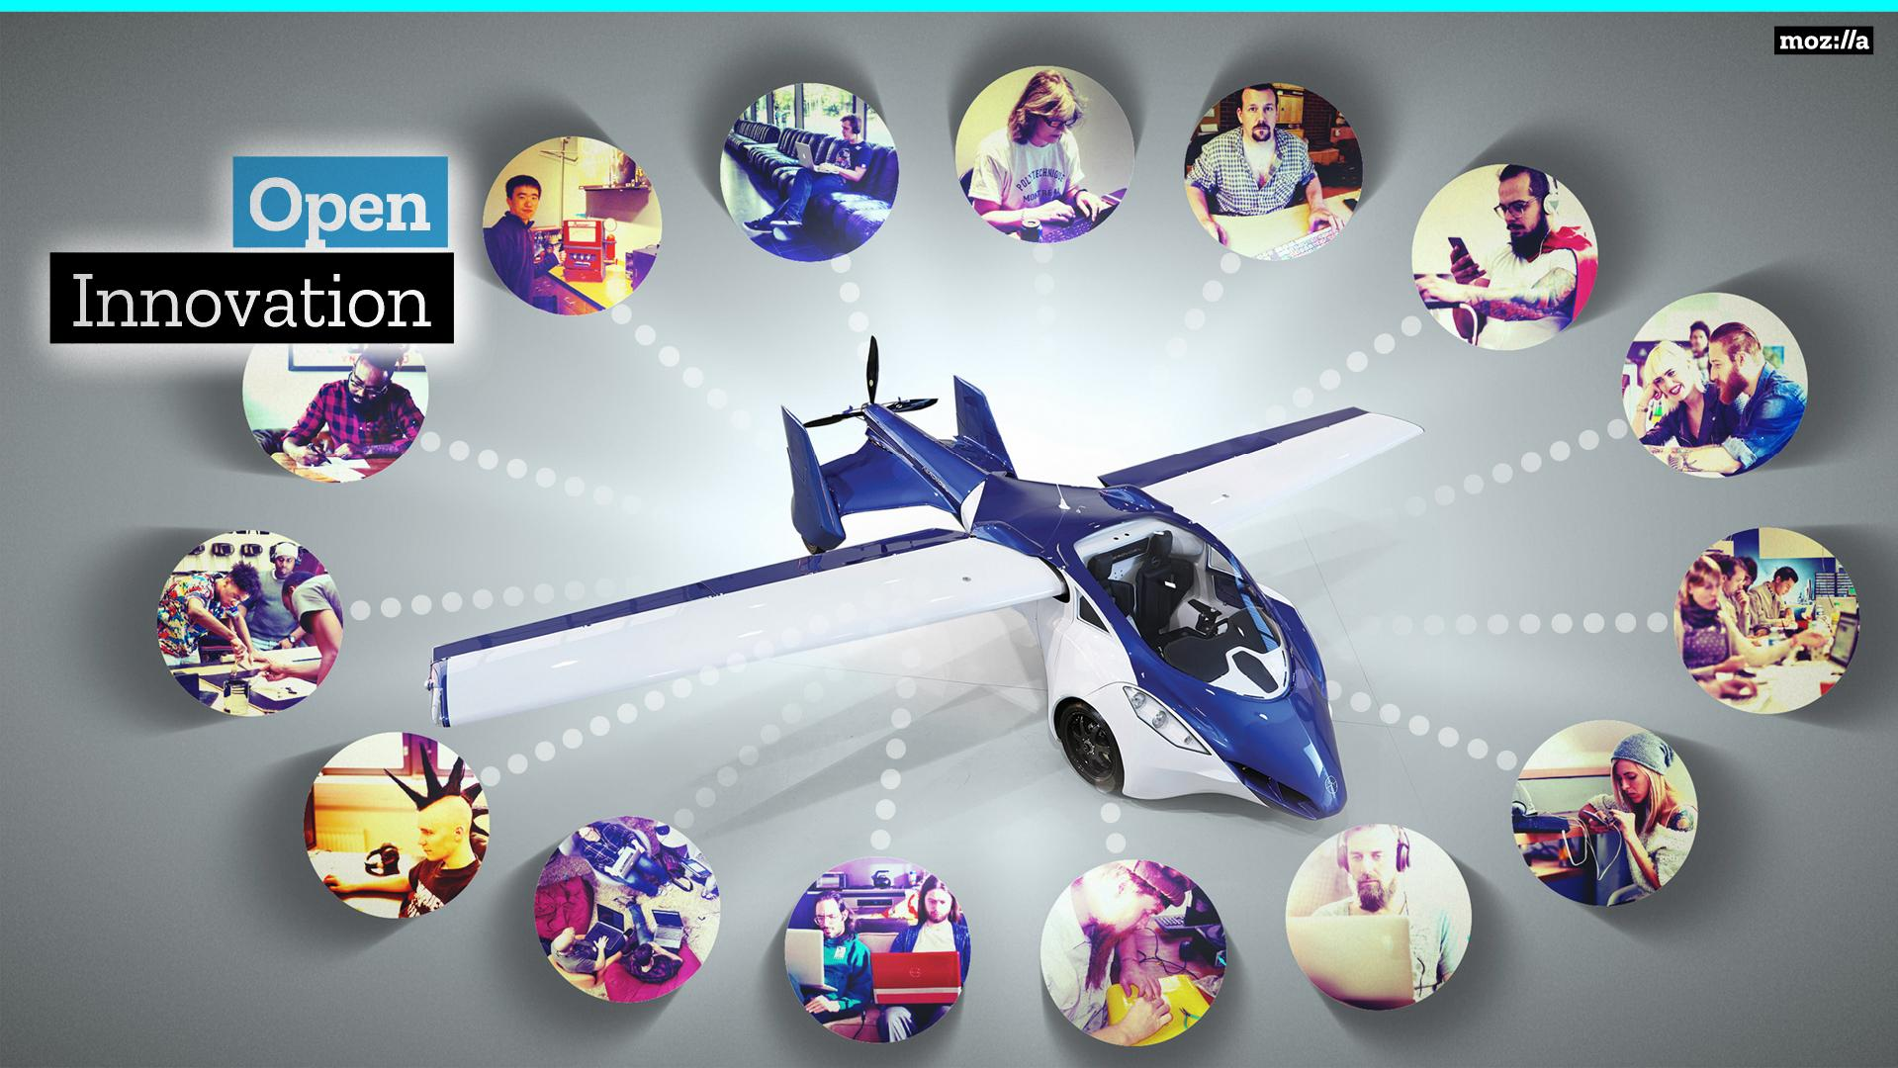
Notes:
What if innovation took place in the open?
Code, data, failures, and successes open for all to see.
This could revolutionize much of innovation
The costly process of creating and curating data would only have to happen once!
Failures would only happen once, not once for each corporation.
With so many eyes on the process, problems could be seen early, not late.
Resources and finances could be pooled, increasing the leverage of all players involved
This is how we operate in Mozilla Machine Learning Group, in the open. Pooling resources, data, and code!
This is also how we operate with respect to Deep Speech and Common Voice.

Slide 8
How Voice Assistants Work
Notes:
However, before I delve into either Deep Speech or Common Voice, I want to frame their discussion by talking about how voice assistants work.
As voice assistants nowadays are familiar to most, speaking of their internals will serve to frame the work we are doing with Deep Speech and Common Voice in a familiar surrounding.

Slide 9
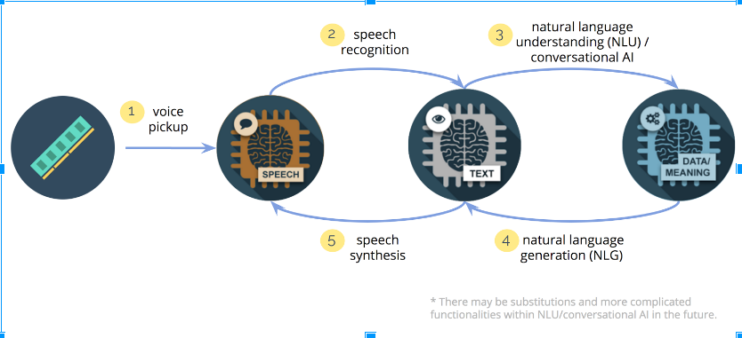
Photo byJerry Lu on Medium
Notes:
Generally, a voice assistant processes information in five steps:
The first step is voice pickup. There a microphone or an array of microphones captures the audio of a user speaking to the voice assistant.
The second step is speech recognition. Here the audio captured during voice pickup is digitized and fed to an program capable of taking this digitized, spoken audio and converting it into a text, a transcript of what the user said.
The third step is natural language understanding. In this step the transcript of the user’s request is “understood” by the system. This could be as simple as “understanding” the user wants to know what time it is or as complicated as “understanding” the user wants an analysis of the root causes of World War I.
The fourth step is natural language generation. Here the system generates a textural response to the user’s query. Continuing our examples, the system would produce a short text indicating the time or, for example, a text, more likely a thesis, indicating the root causes of World War I.
The fifth, and final step, is speech synthesis. Here the system takes the text produced by natural language generation and renders it into spoken form.
Now, the projects I am going to talk about today, Deep Speech and Common Voice, are only concerned with the second step, speech recognition.
I’ll not be touching in any detail on the various other steps, just speech recognition.

Slide 10
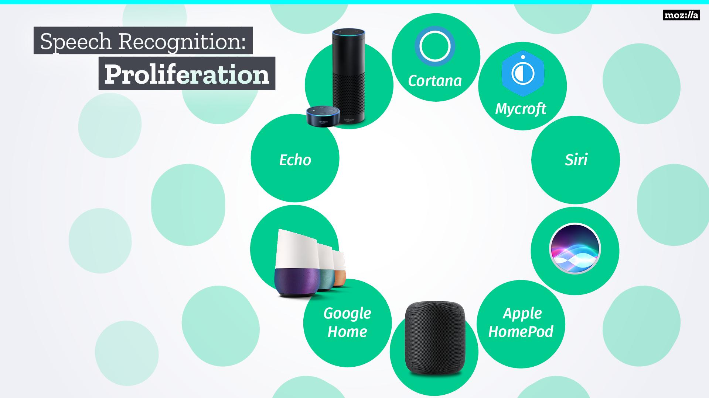
Notes:
Now let’s talk about the voice assistant market.
At the forefront of this market, is the rise of “smart speakers” like Echo, Google Home, and Apple HomePod.
One may initially think this a rather healthy state of affairs, several competitors in the market each vying for user’s attention and business.
And to a limited extent this is so…..

Slide 11
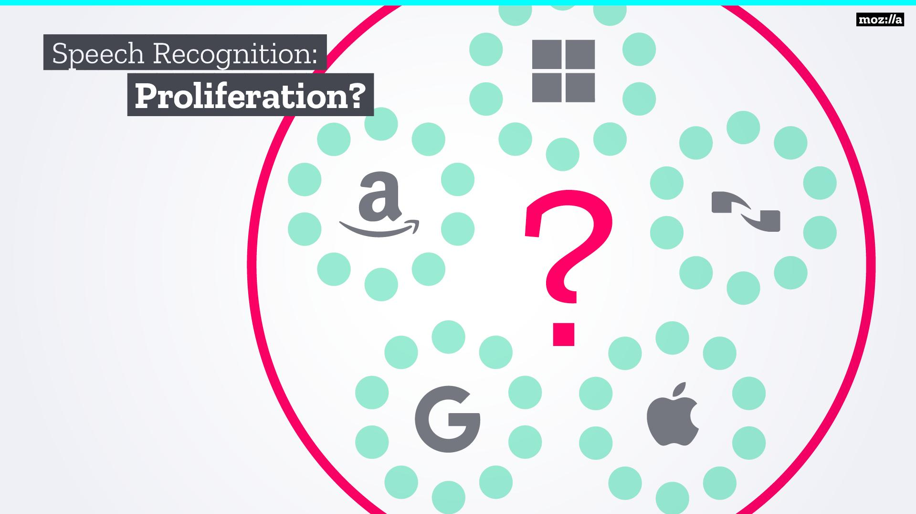
Notes:
However, if one looks behind the scenes of this technology, then you’ll see that there are only a few large players who power the entire industry.
There is a reasons for this: voice recognition is hard. Besides obtaining the data required to train a speech recognition engine, which is already barrier enough, to build a independent speech product you need:
A team of machine learning experts which is usually hard to find
Vast computational resources of highly specialized hardware
Legal help to navigate the patent minefield in this arena and then
You still have to build your assistant which is an entire other set of problems
This sets up a winner-takes-all scenario where only the larger companies can compete.
We think this stifles innovation, and leaves many (researchers, start-ups, governments, hobbyists) unable to overcome this substantial economic burden.

Slide 12
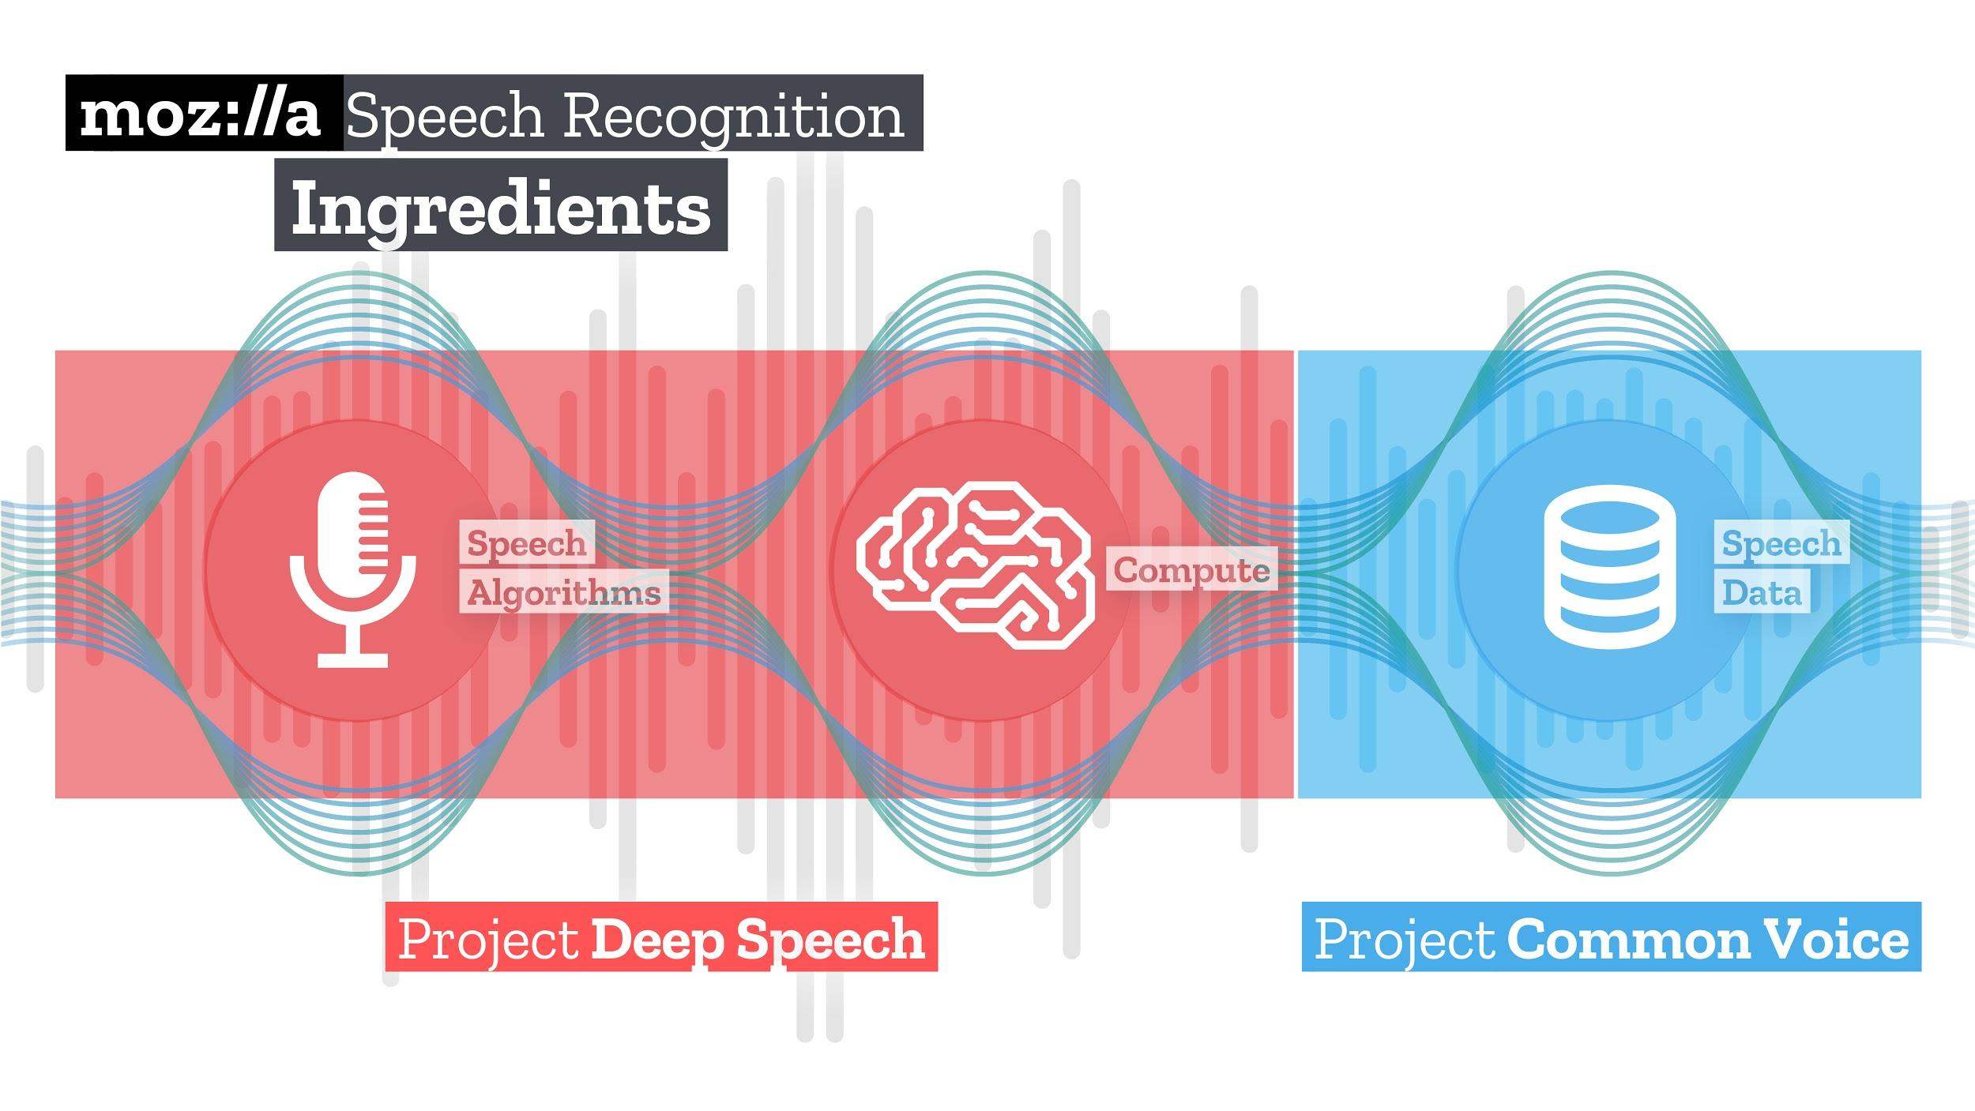
Notes:
Now I want to dive down a bit in to speech recognition
Basically, speech recognition requires three ingredients:
Speech algorithms which learn how to understand speech
Compute to train these algorithms with and
Speech data, audio + transcript pairings, from which the algorithm learns how to understand speech
With the market in the state it is, Mozilla decided to put its finger on the scales of speech recognition and tilt them back to the direction of researchers, start-ups, governments, and hobbyists.
We are doing this through the projects Deep Speech, an open source speech recognition engine, and Common Voice, a website and app used to collect open speech data.
Deep Speech provides the speech algorithms and compute required for speech recognition.
While Common Voice provides the speech data required to train a speech recognition model.

Slide 13
Project DeepSpeech
Notes:
With that as a framing, I wanted to now give an introduction to Deep Speech, our open speech recognition engine.

Slide 14

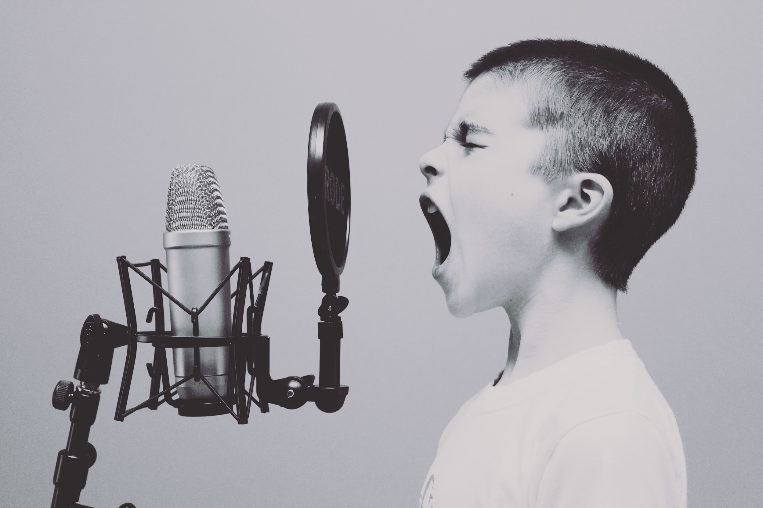


I Introduction: Speech-to-Text
"Mr. Watson, come here. I want to see you."
Speech
Computation
Text
Notes:
Generally, speech recognition consists of three stages
First, speech is presented to a microphone and digitized into a sequence of ones and zeros
Second, this sequence of ones and zeros is computed on using one of a number of algorithms
Third, text representing the transcript of what was initially said is produced
These three stages are present in any speech recognition engine present in the market.

Slide 15
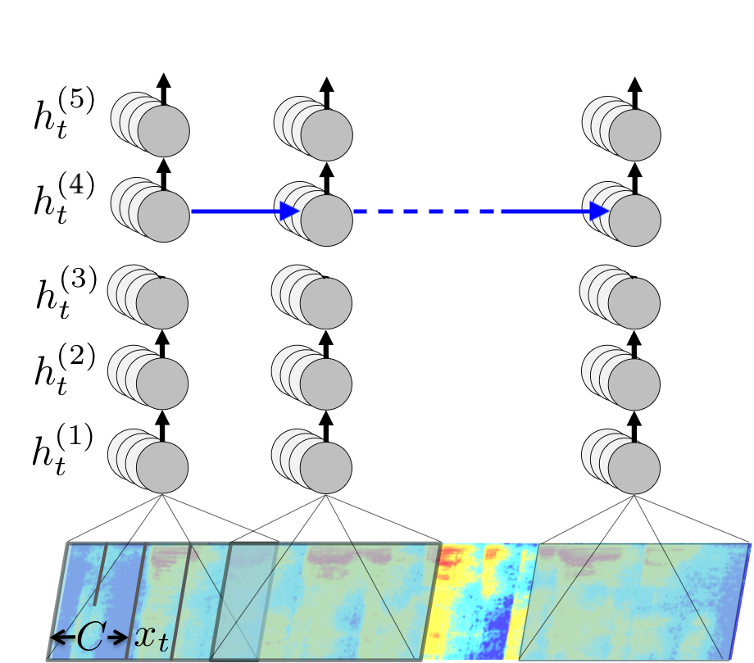
I Introduction: Deep Learning
Deep Learning
Notes:
One distinguishing feature of our engine is that the computational stage makes use of “Deep Learning”
Deep Learning is a branch of machine learning that utilizes computational units motivated by neurons in the brain.
These computational units, artificial neurons, are arranged in to nets, the outputs of artificial neurons feeding into the inputs other artificial neurons.
Like neurons in the brain, these artificial neurons produce an output conditioned on the inputs they receive.
Thus, stringing many of these artificial neurons together produces a net capable of computing in a manner not unlike that in the brain.

Slide 16

I Introduction: Deep Learning + Speech-to-Text
Speech-to-Text
Deep Learning
Notes:
What we are going to be concentrating on in this talk is the intersection of these two fields of study, speech recognition and deep learning.
So, let’s get started.

Slide 17

II Speech Recognition Ingredients: Algorithms
Notes:
As previously mentioned, speech recognition requires three ingredients:
Speech algorithms
Computational resources and
Speech data
Next I want to talk about the speech algorithm ingredient of Deep Speech

Slide 18

II Speech Recognition Ingredients: Algorithms
CTC Algorithm
Soft-Max Layer
Feed Forward Layer
Recurrent Layer
Feed Forward Layers
Speech Features
Notes:
The speech algorithm employed by Deep Speech is relatively straightforward when compared to other speech recognition algorithms.
The audio signal from a speaker is segmented into windows, and each window is transformed into a vector using a technique similar to a Fourier transform
These vectors are fed to several so-called fully connected layers, meaning all the artificial neurons in one layer serve as inputs to each neuron on the next layer
This is followed by a so-called recurrent layer which captures the time dependent features of speech
Finally, there is another feedforward layer and softmax layer that indicates which letter the engine hears in each time window
Training is done using the so-called CTC loss, which allows the system to be easily taught from the “ground truth” transcript of the audio
That’s it; this is the Deep Speech architecture. Simple but effective.

Slide 19
II Speech Recognition Ingredients: Compute
Notes:
As we’ve touched upon the speech algorithm ingredient required for speech recognition, I want to next move onto the compute ingredient, which is often overlooked.

Slide 20
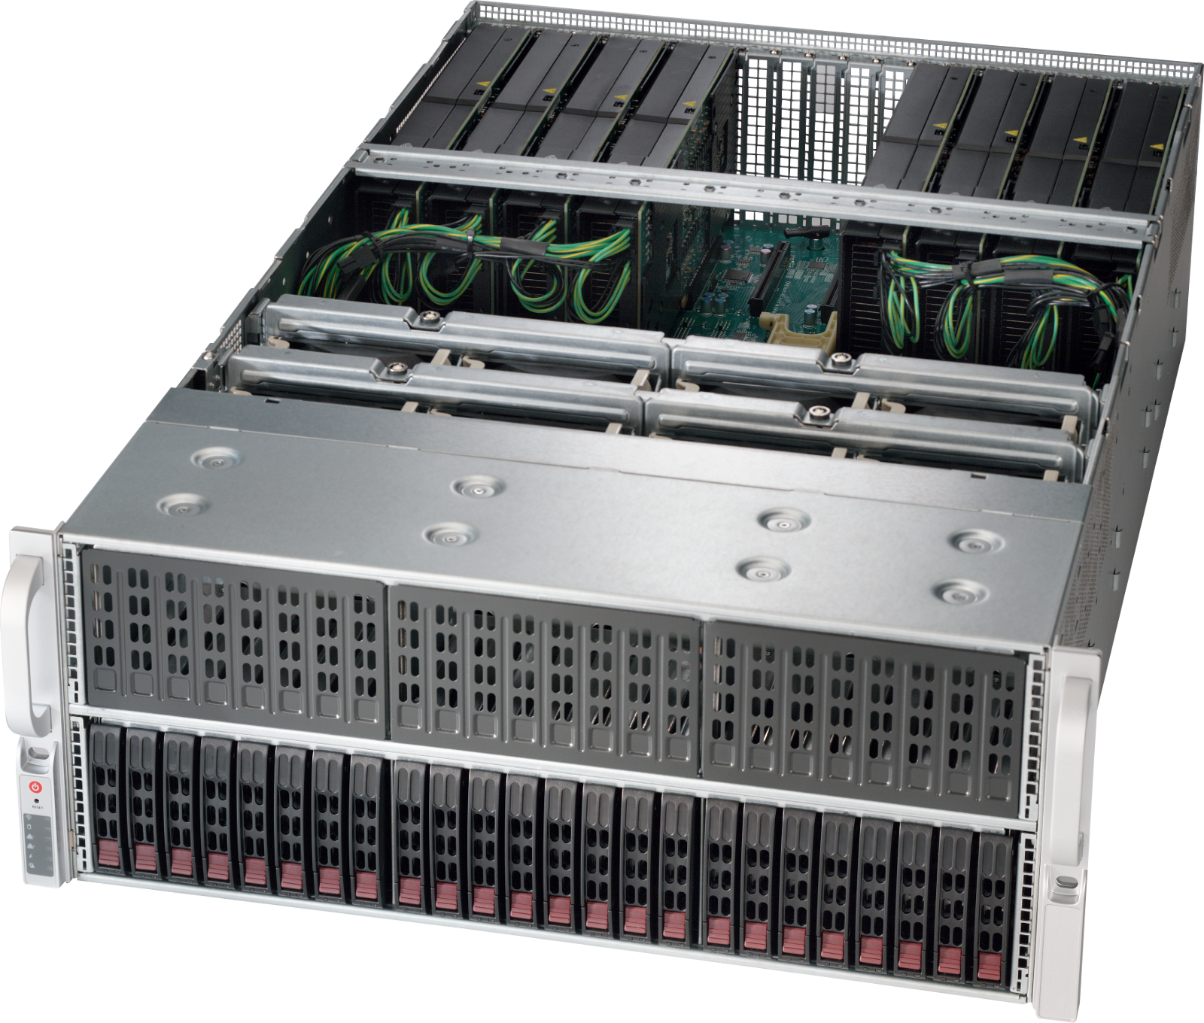
II Speech Recognition Ingredients: Compute
Headnode with 200 times disk space of a new MacBook Pro
4 Worker Nodes
Each Worker Node
  46 times GPU performance of new MacBook Pro
  10 times networking speed of new MacBook Pro
  8 times RAM of new MacBook Pro
Notes:
Generally we train our system on a moderate to small set of speech data, about 3.5k hours of transcribed speech.
Despite this, the computational resources required are not modest.
Our system consists of a...
Headnode with 200 times disk space of a new MacBook Pro (In other words 100 TB)
4 Worker Nodes
Each Worker Node has
46 times GPU performance of new MacBook Pro (In other words 88 TFlops of compte)
10 times networking speed of new MacBook Pro (10Gb ethernet)
8 times RAM of new MacBook Pro (128 GB of RAM)
Despite all this compute power, training is still not quick.
Training a release model for English takes 4 days of continuous computation on one of these worker nodes.

Slide 21
II Speech Recognition Ingredients: Data
Notes:
As we’ve touched upon the speech algorithm and compute ingredients required for speech recognition, I want to next move onto the speech data ingredient which is sorely lacking in the open source world.

Slide 22


II Speech Recognition Ingredients: Data
Switchboard Corpus
Fisher Corpus
LibriSpeech
Notes:
Generally, to train a speech recognition engine to a production level of quality you need about 10k hours of transcribed data.
Data sets of this size are few and far between for English, they exist only behind the walls of a handful of corporate giants and these data sets aren’t for sale.
Worse still, there are no open data sets of this size for English or any other language.
So to train our English engine we cobbled together about 3.5k hours of transcribed data from open sources, such as LibriSpeech and Common Voice, and sources we paid for, such as Fisher and Switchboard, which unfortunately are very expensive.
The 3.5k hours we use is sufficient to create a good speech recognition engine. However, for English we still are 6.5k hours, well shy of the 10k hour mark! That’s not even mentioning other languages!
So to help us, and others with this problem, we started Common Voice...

Slide 23
Project Common Voice
Notes:
Common Voice, is an app and website that crowdsources the creation of open speech data sets in many languages

Slide 24

Common Voice
Open Ideation
Expert Engagement
Licensing
Micro-task
Crowdsourcing
Community Engagement
Notes:
However, Common Voice is more than simply an app and a website.
Is was created through an open ideation process with the help of the Mozilla community.
In addition, its creation pulled in expert engagement to ensure best practices were being followed with respect to issue such as data preparation.
Also the licensing model selected for Common Voice is a open as possible, all transcripts and audio clips are release under a CC-0 license.
Furthermore, our micro-task model found active support in various language communities passionate about bringing speech recognition to their languages

Slide 25
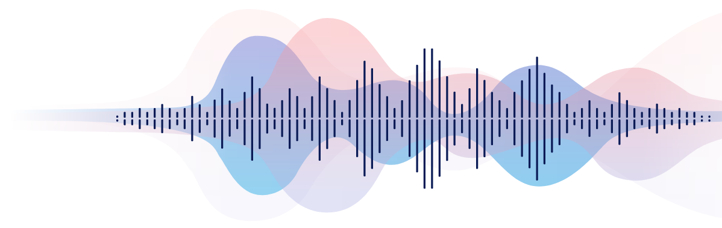

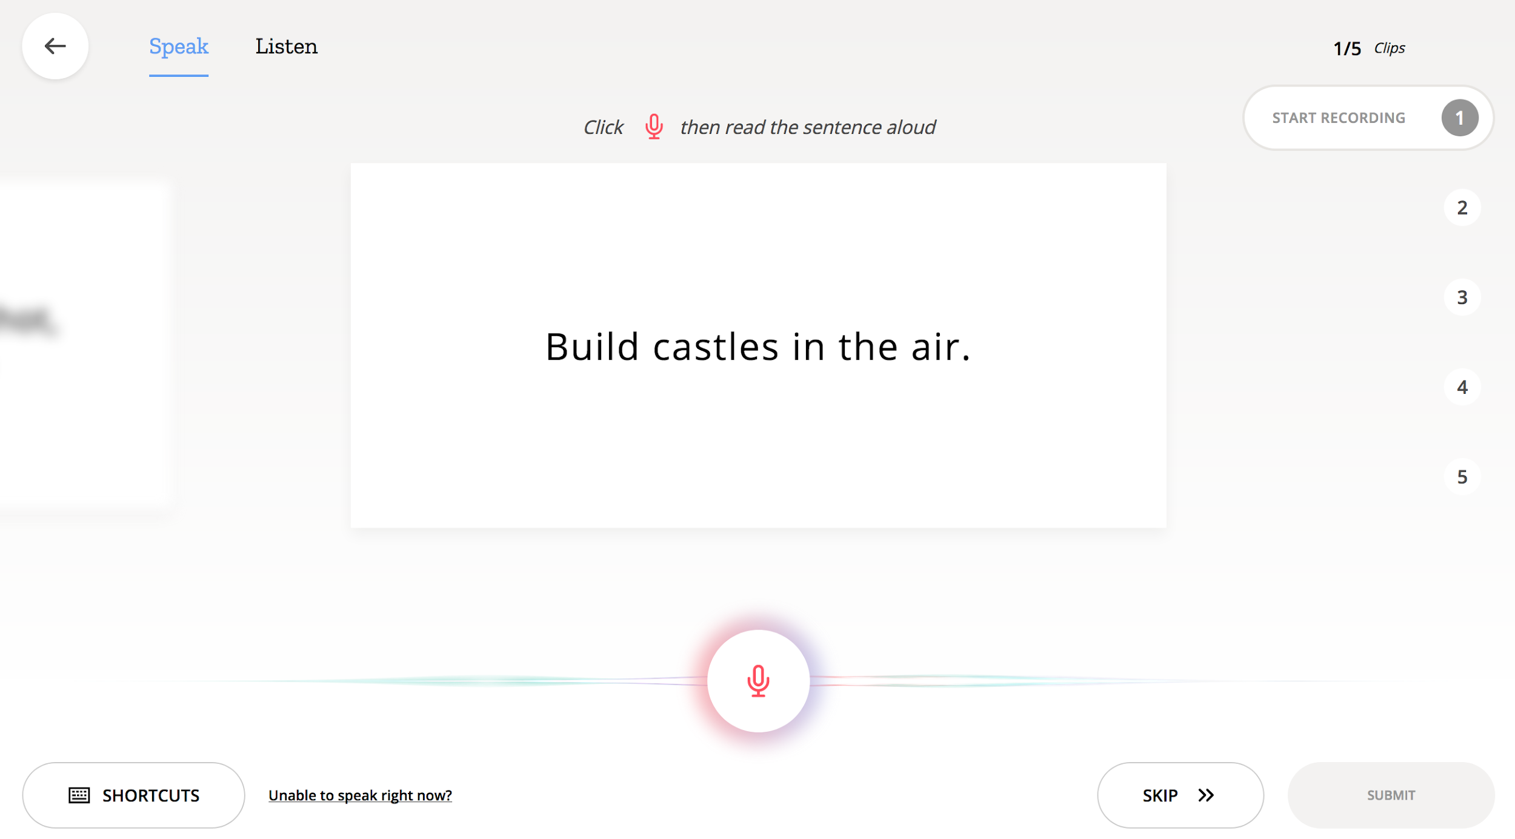


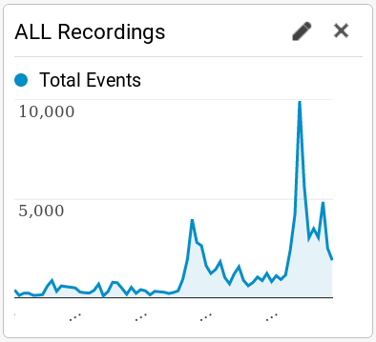
Common Voice
Democratizing speech technologies through Open Innovation
Approach
Crowdsourcing
Collaborations:
  corporate
  institutional
  governmental
  academic
Community development
Open-source software
Goal: influencing the large and developing speech ecosystem to be more open, accessible, and inclusive.
Notes:
So generally the approach Common Voice takes is to be as open as possible
Crowdsourcing
Collaborations:
corporate
institutional
governmental
academic
Community development
Open-source software
The reason we are so open is that our goal is to make the speech ecosystem more open, accessible, and inclusive.

Slide 26
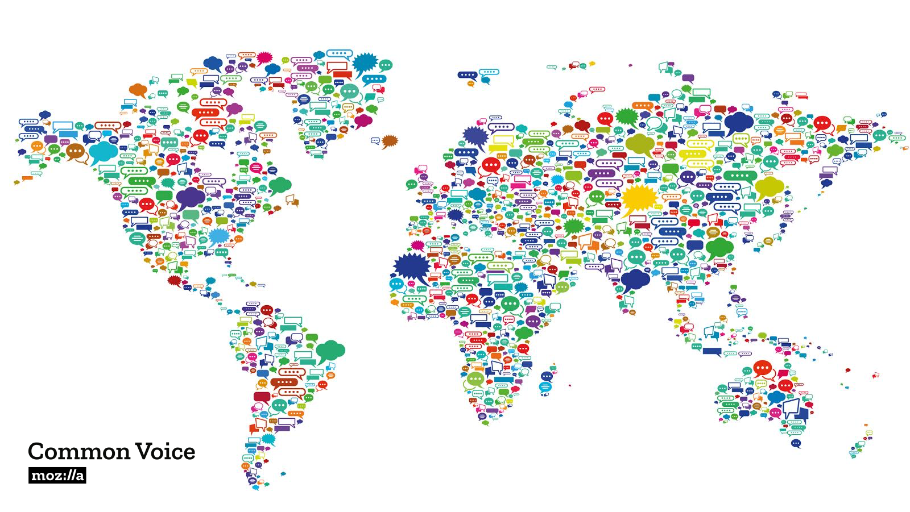
Common Voice
Democratizing speech technologies through Open Innovation
Progress
940 hrs of English voice data
from 112 countries
Common Voice will soon be largest open speech dataset.
data collection in 20 languages
60+ languages in-progress
We see accelerated growth
Technology collaborations
  Mycroft
  Snips.AI
  Bangor University in Wales
Notes:
And to some extent we are succeeding. So far Common Voice has gotten...
940 hrs of English voice data
from 112 countries
Common Voice will soon be largest open speech dataset.
data collection in 20 languages
60+ languages in-progress
We see accelerated growth
Technology collaborations
Mycroft
Snips.AI
Bangor University in Wales

Slide 27
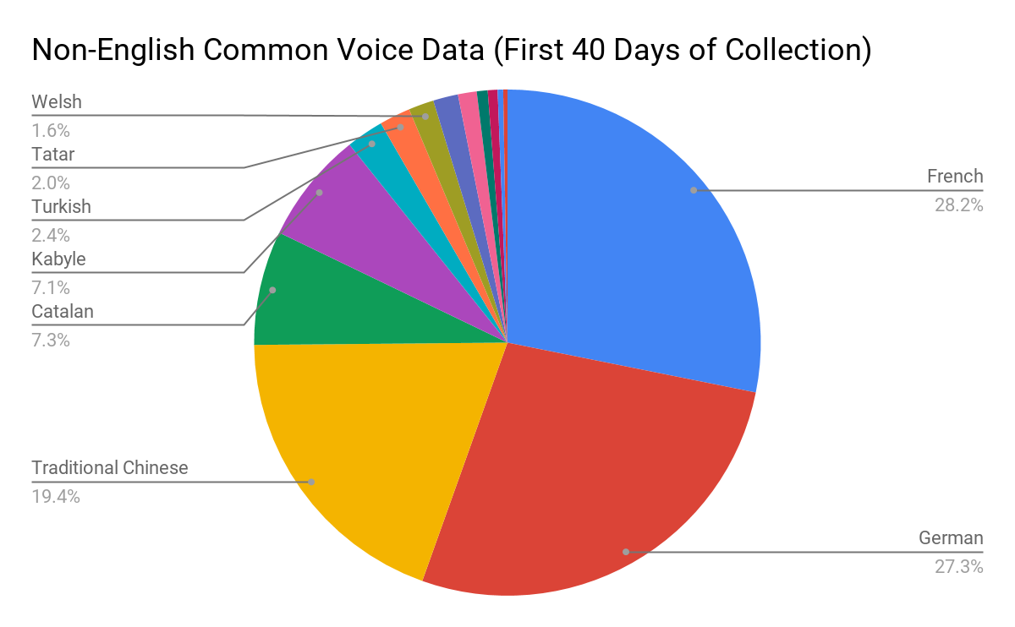
Common Voice
Democratizing speech technologies through Open Innovation
Progress
52 hrs
36 hrs
51 hrs
Notes:
To give a feel for how quickly things took off for multi-language collection….
In the first 40 days of opening up Common Voice to languages other than English we saw an amazing response. In those first 40 days we collected...
52 hours of French
51 hours of German
36 hours of traditional Chinese Mandarin
And smaller number of hours from various other languages
Honestly, we were humbled and surprised by the amazing response of the language communities!

Slide 28

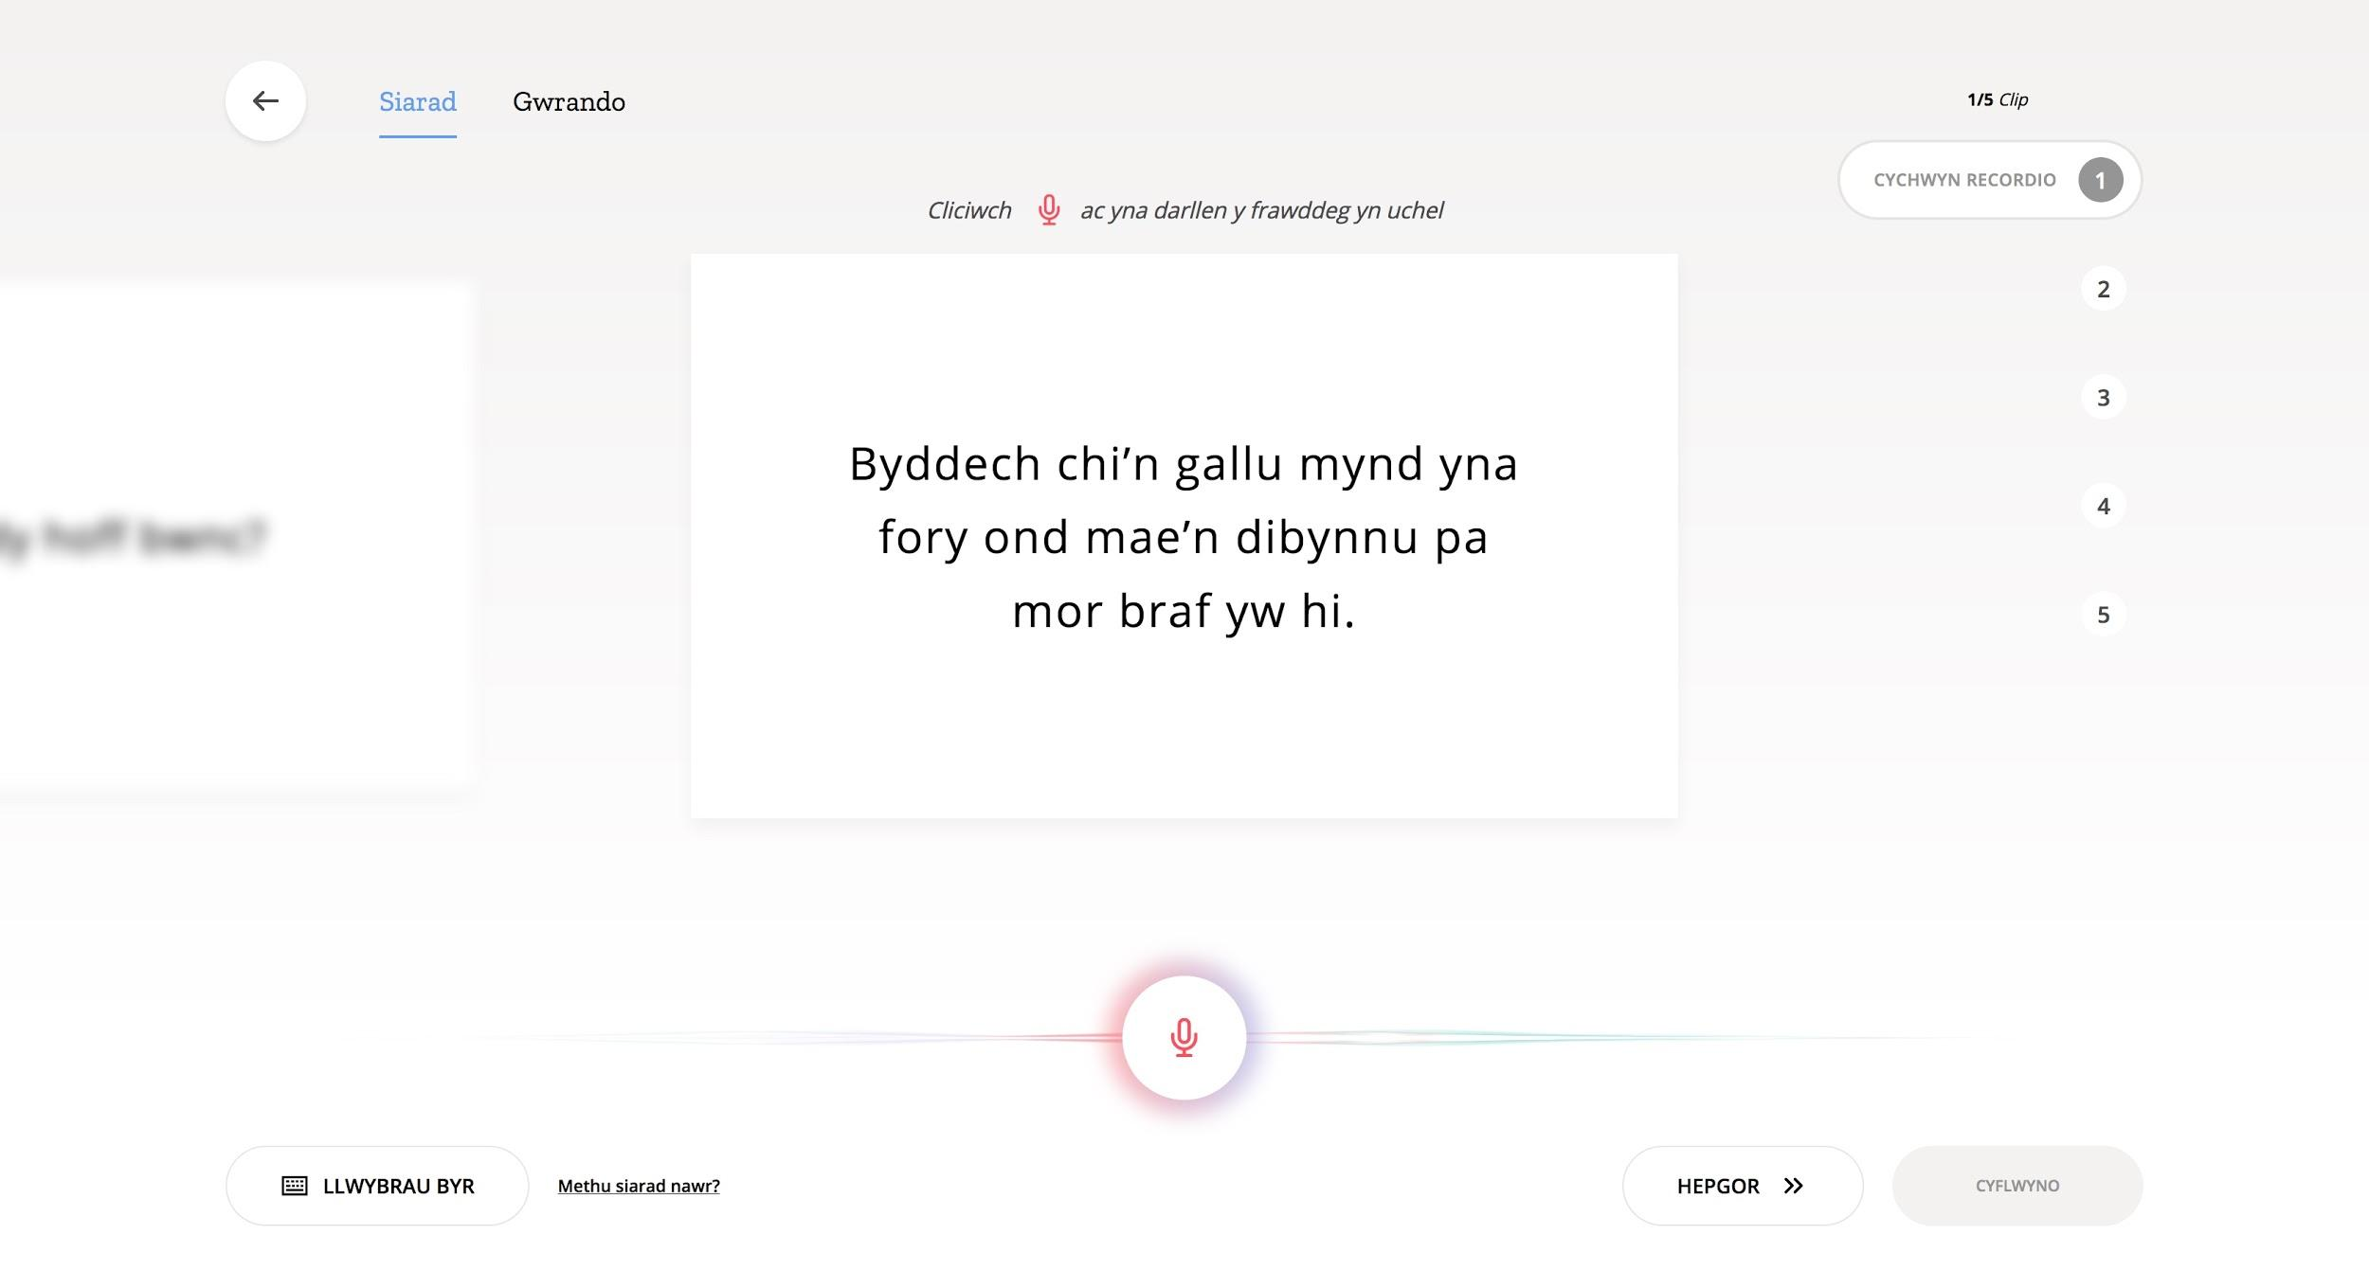
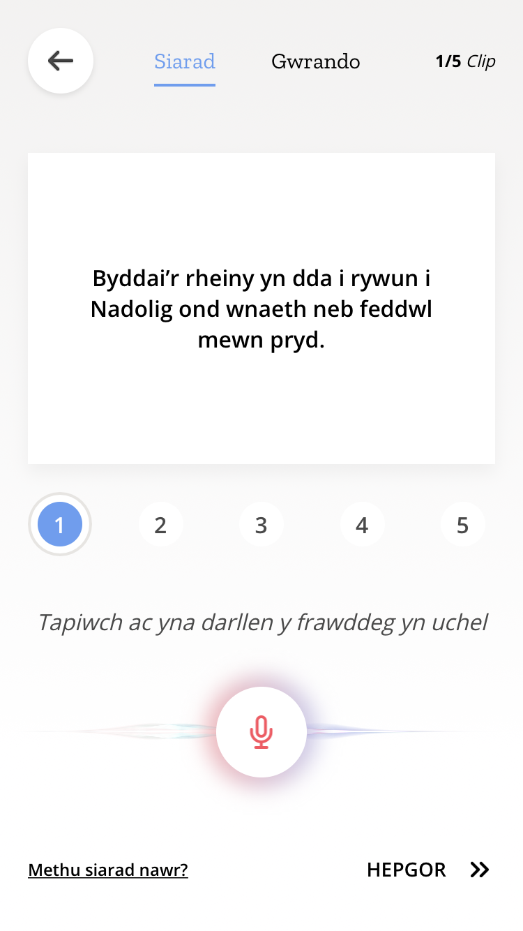
voice.mozilla.org - How it Works
Speak
Notes:
So how does Common Voice work?
Common Voice basically has three components: the speak component, the listen component, and the data commons component.
In the speak component, shown here, a user is presented with a sentence and asked to read it aloud, recording the results.
If a mistake is made in reading the sentence, the chance is given to re-read it or move onto another sentence.
Once the user is happy with their reading of this sentence and 4 others they are asked to read, they can submit them to Common Voice
and this is where the next “listen component” plays a role

Slide 29
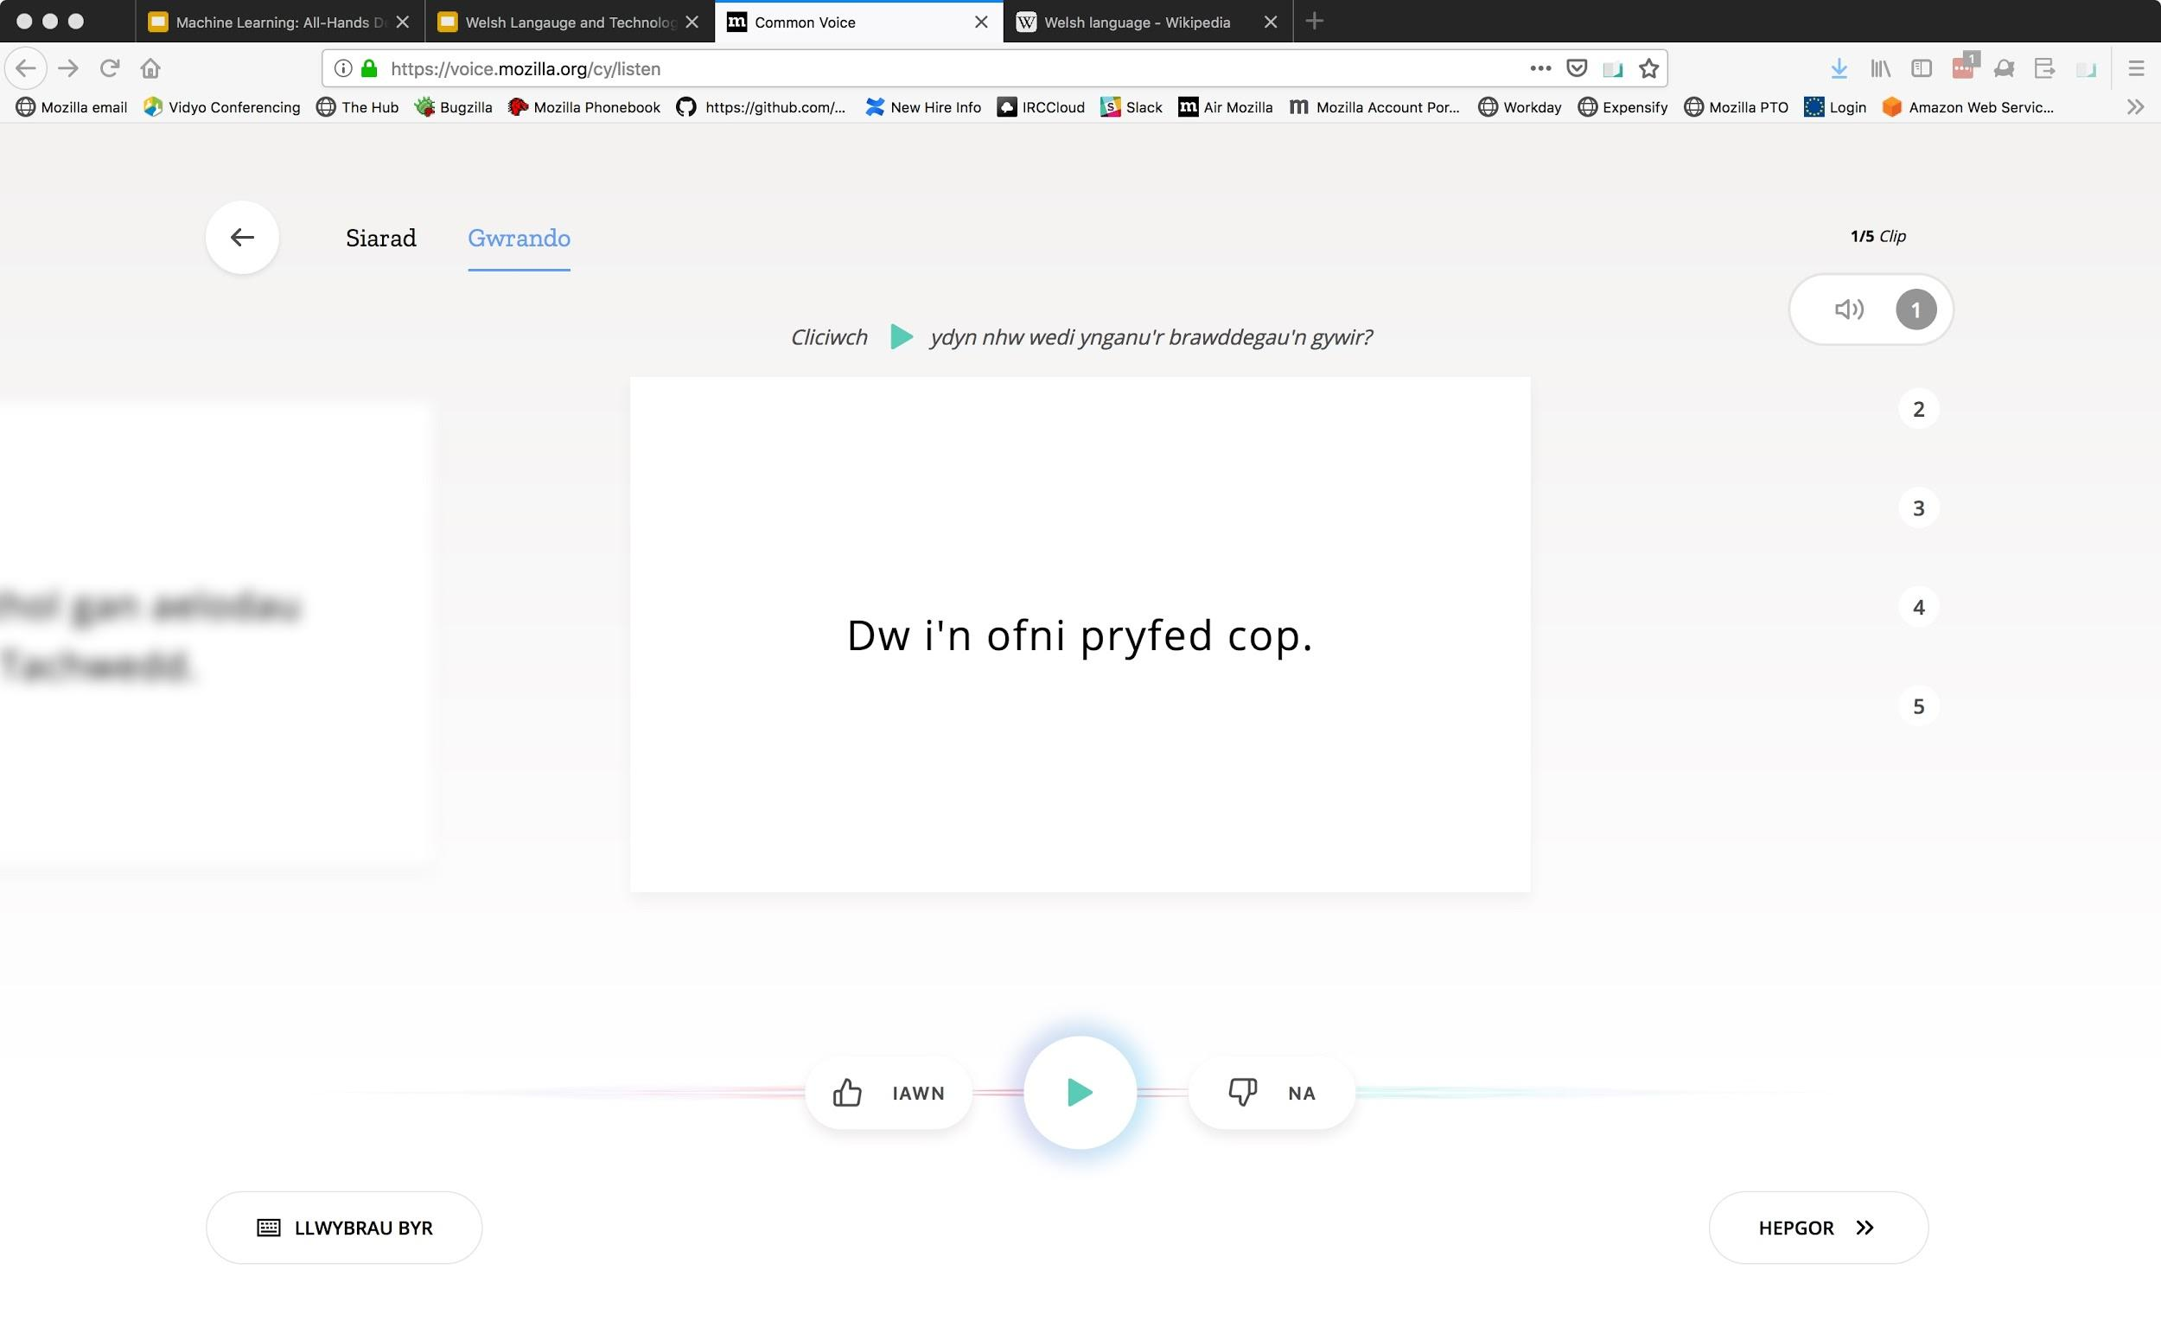
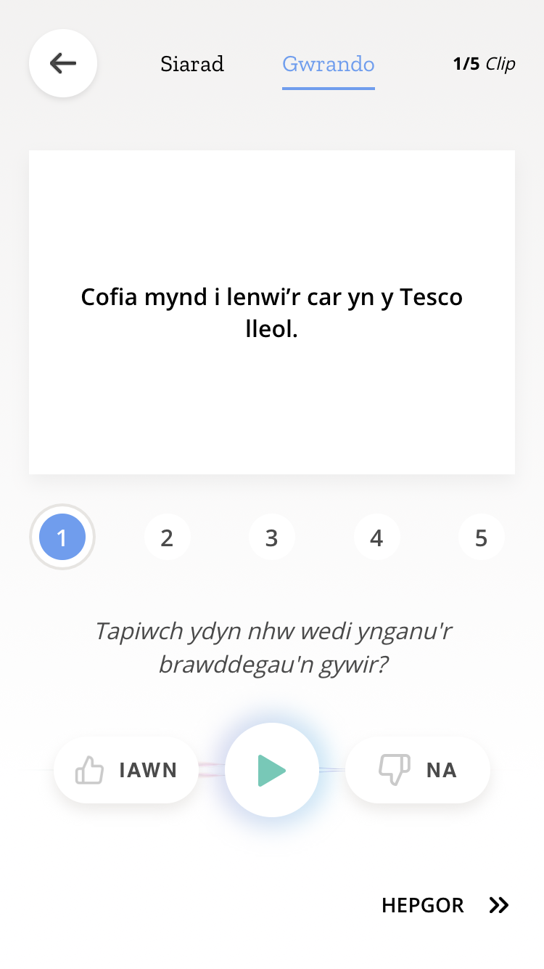
voice.mozilla.org - How it Works
Listen
Notes:
The listen component, pictured here, presents the user with a sentence and the audio of a second user reading this sentence.
The user then listens to this audio and votes, up or down, if the second user read the sentence correctly.
This provides a measure of quality assurance on the audio captured by Common Voice.
In particular, three people must listen to each clip and two of them must “up vote it” before it’s considered validated.

Slide 30
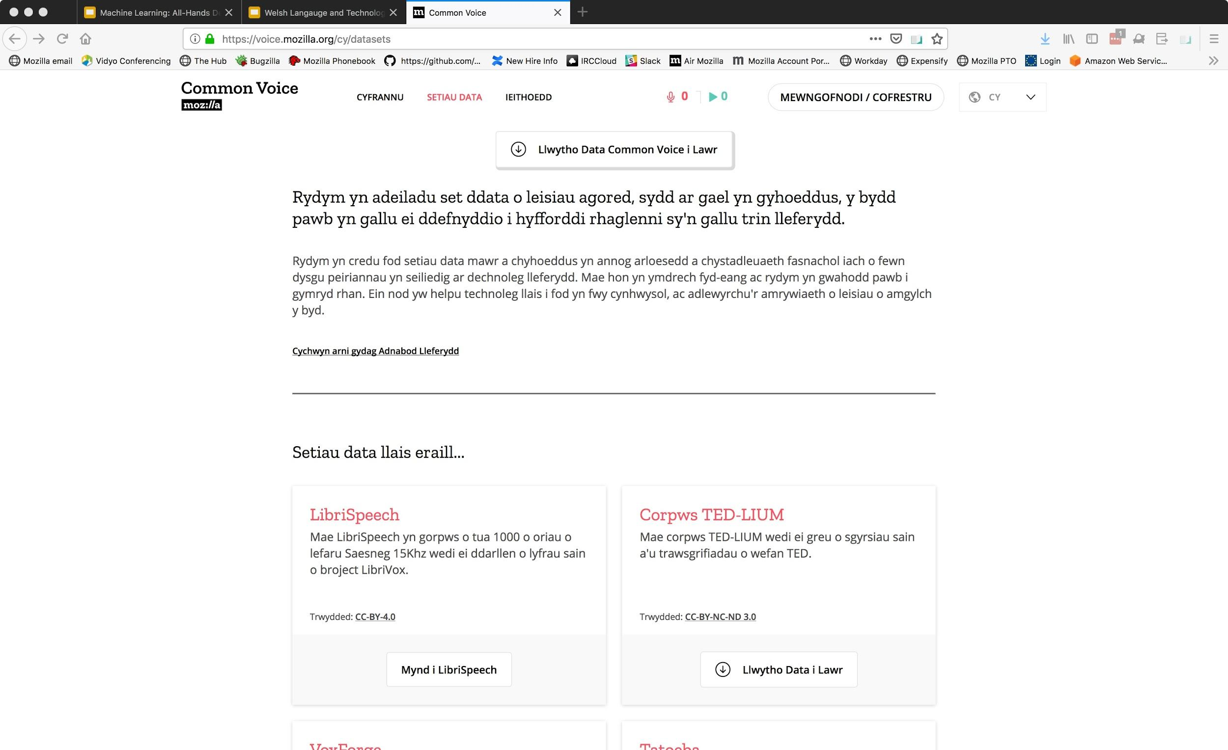
voice.mozilla.org - How it Works
Data Commons
Notes:
Finally there is the data commons component, where the community is able to download the data created by the Common Voice community.
This Common Voices data sets are released under a CC-0 license and contain all the audio and transcripts provided by the Common Voice community.
In addition, the data commons component contains various other open data sets that can be used for speech recognition such as LibriSpeech.

Slide 31
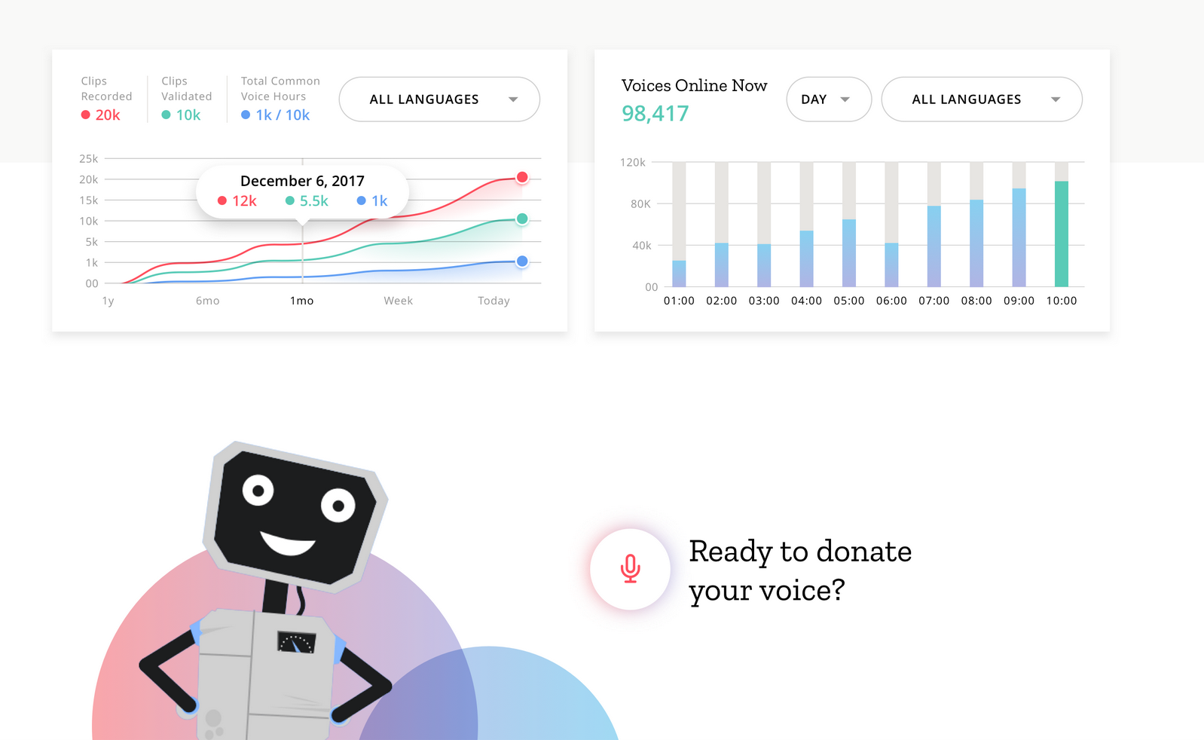
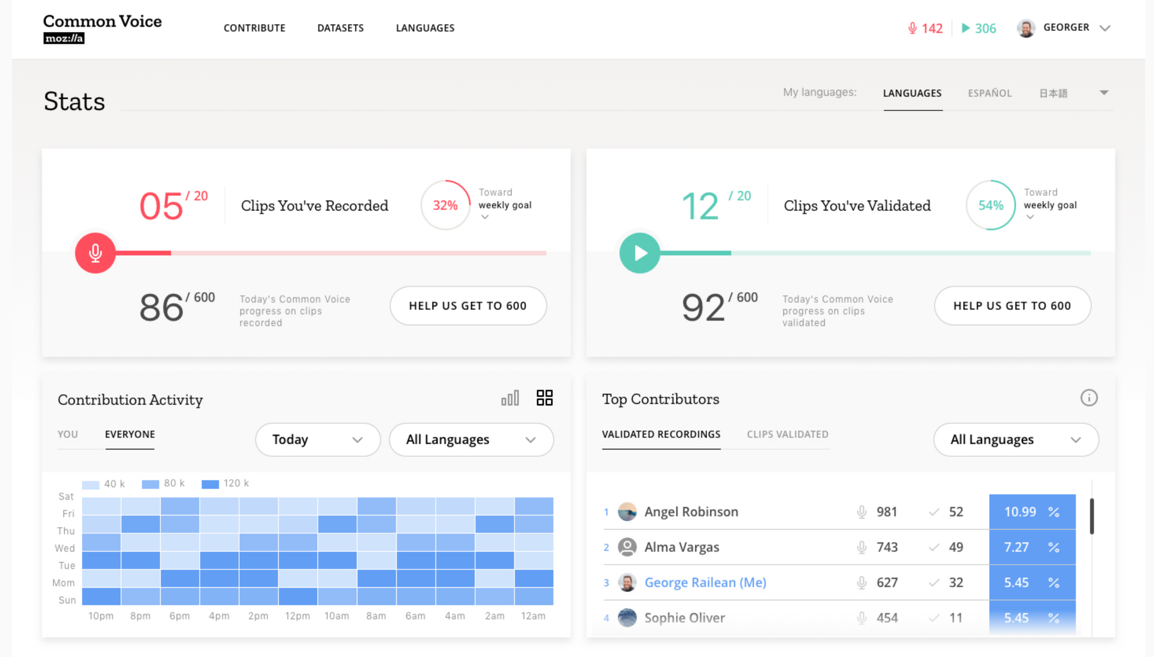
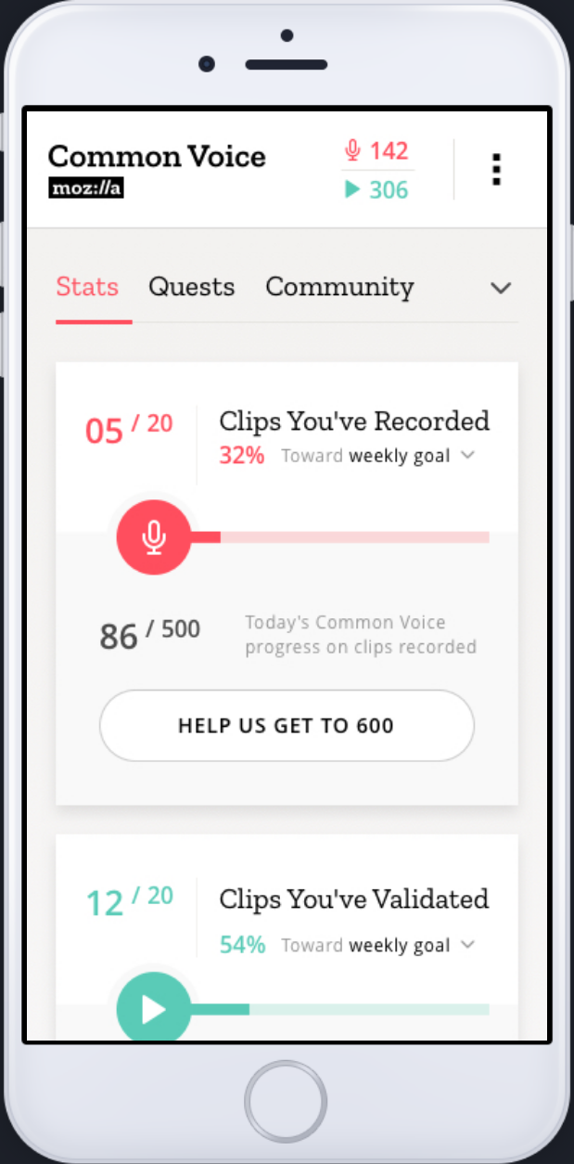
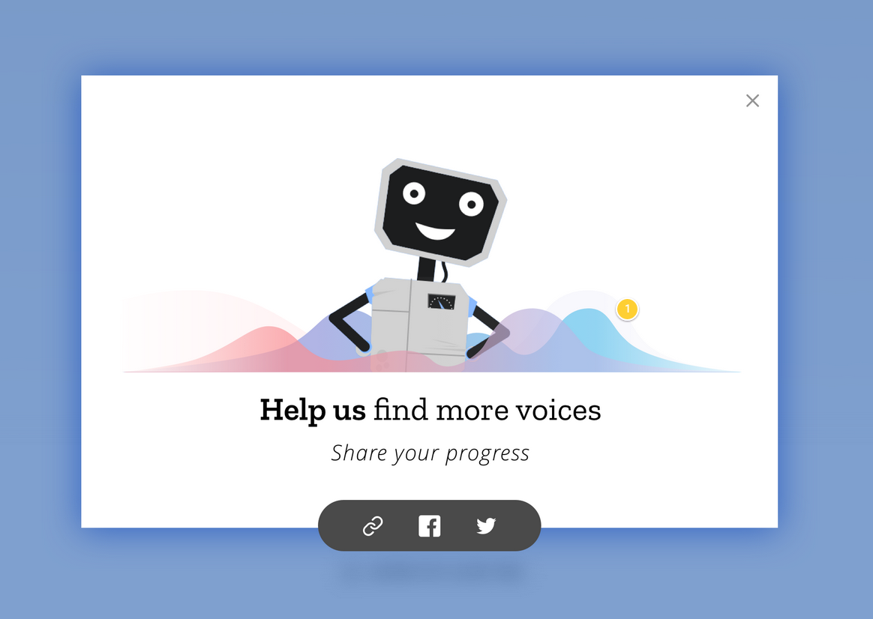
Common Voice
Democratizing speech technologies through Open Innovation
Common Voice v2.0!
Notes:
FInally I’d like to conclude by saying I strongly encourage you to explore Common Voice for yourselves at voice.mozilla.org
We’ve added many new features recently including language statistics, user statistics, leader boards, and many other stats that will help you and your community track the progress of your language.

Slide 32
Рахмат!
Common Voice https://github.com/mozilla/voice-web
DeepSpeech https://github.com/mozilla/deepspeech

